Slide 1


Building Custom Websites With the Luminate Online API
Noah Cooper
Advisory Web Developer,
Blackbaud

Slide 2

Noah Cooper
linkedin.com/in/noahcooper
Advisory Web Developer
AT BLACKBAUD
13 years
Frederick, MD
I live in Western Maryland with my wife Sarah and our two sons, Kjonaas and Kieran. I develop custom solutions for Luminate Online customers, with an emphasis on peer-to-peer fundraising using TeamRaiser. I have a love/hate relationship with JavaScript.

Slide 3
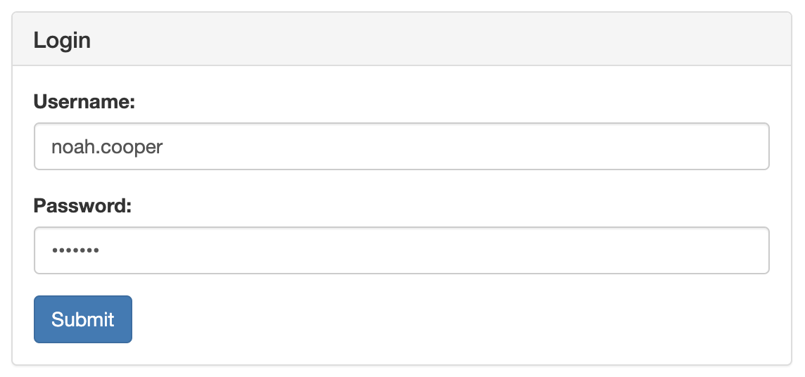
Login
login

Slide 4

A Note on Third-Party Cookies
Some browsers, such as Internet Explorer and Safari, default to blocking third-party cookies from websites which the user has not visited. This can impact the ability to make some cross-domain requests that involve authentication. For example, if a user visits a website your organization hosts outside of Luminate Online before they ever visit a Luminate Online page, and logs in using the login API method, no session cookie will be set, and on subsequent visits they will not be recognized as logged in. To prevent this issue, it is recommended to use a client-side redirect after successful login to force a session cookie to be set. The login method returns a nonce for just this purpose.

Slide 5
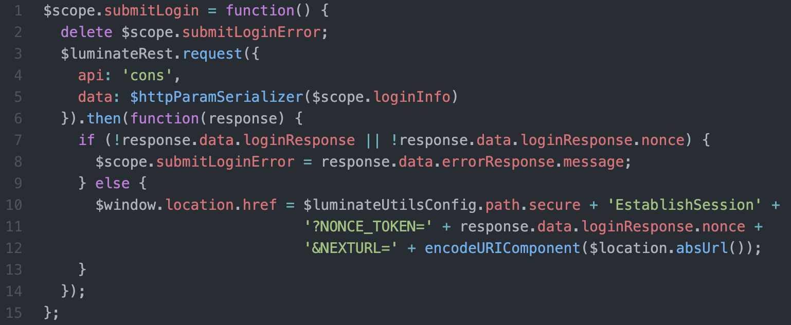
Login
login

Slide 6
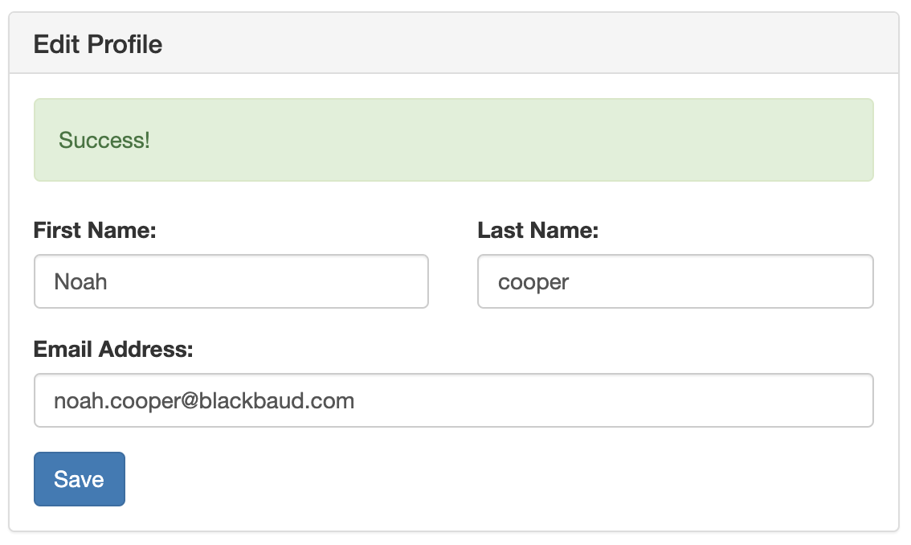
Profile Management
getUser update

Slide 7
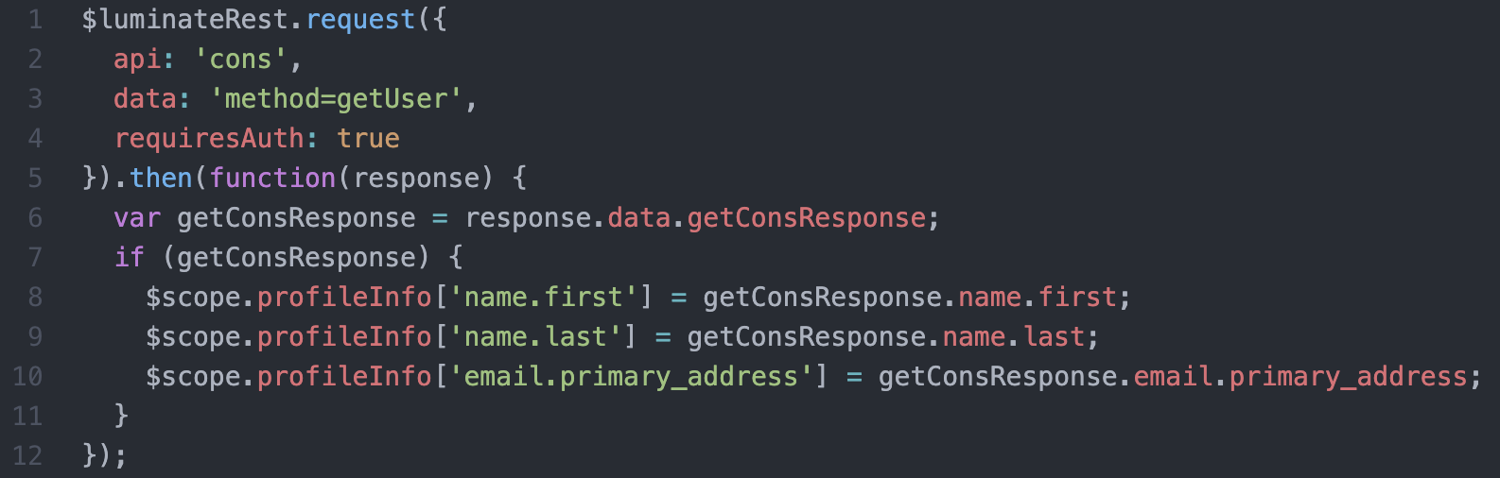
Profile Management
getUser

Slide 8
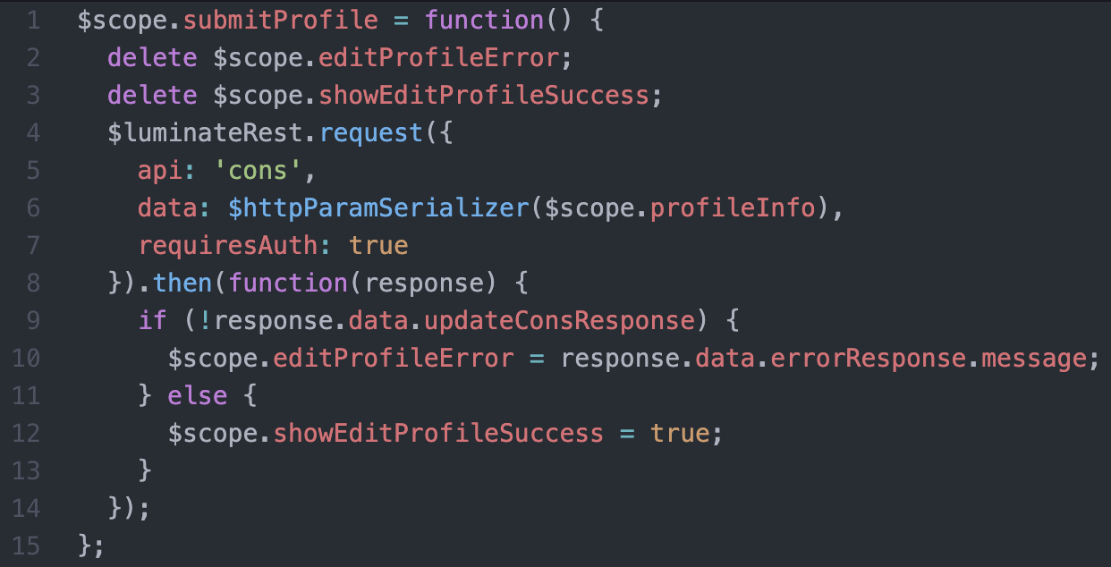
Profile Management
update

Slide 9
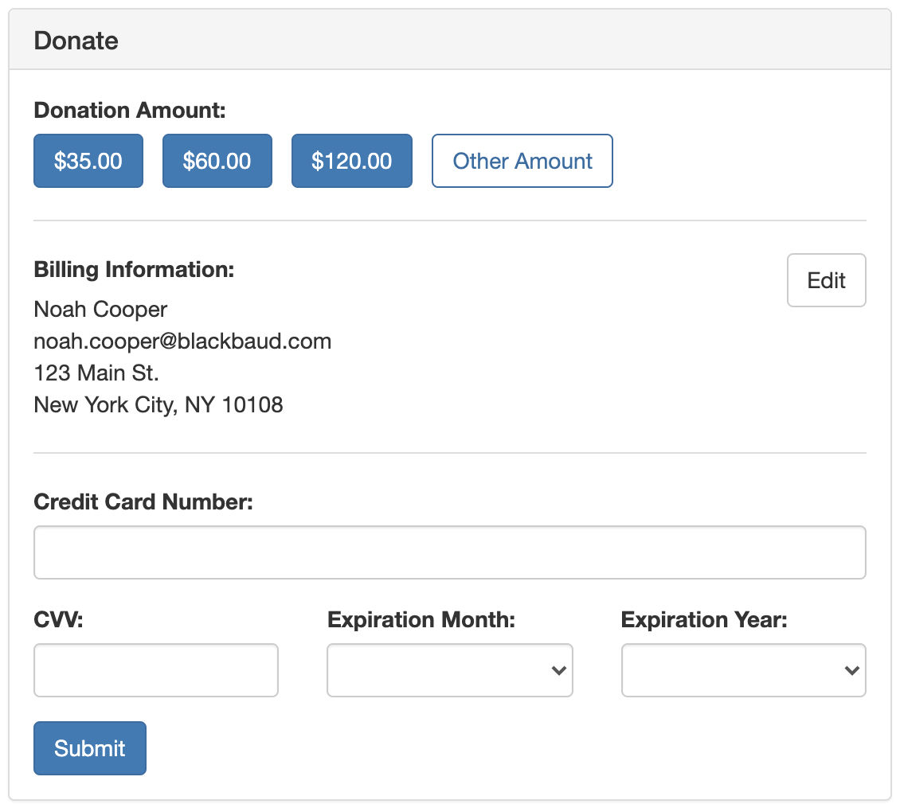
Donation Forms
getDonationFormInfo donate

Slide 10

For PCI Compliance, Never Proxy Donations
As donation requests include credit card information, you must always call the Luminate Online API from the client, and never pass request data through any intermediary server. In other words, you should never write any code in a server-side language such as PHP, C#, or Node.js to call the donate API method – use JavaScript (running in the browser) or redirect URLs only.

Slide 11
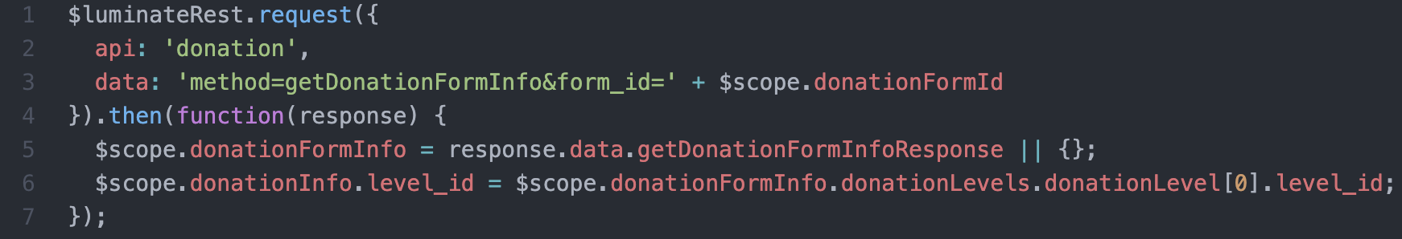
Donation Forms
getDonationFormInfo

Slide 12
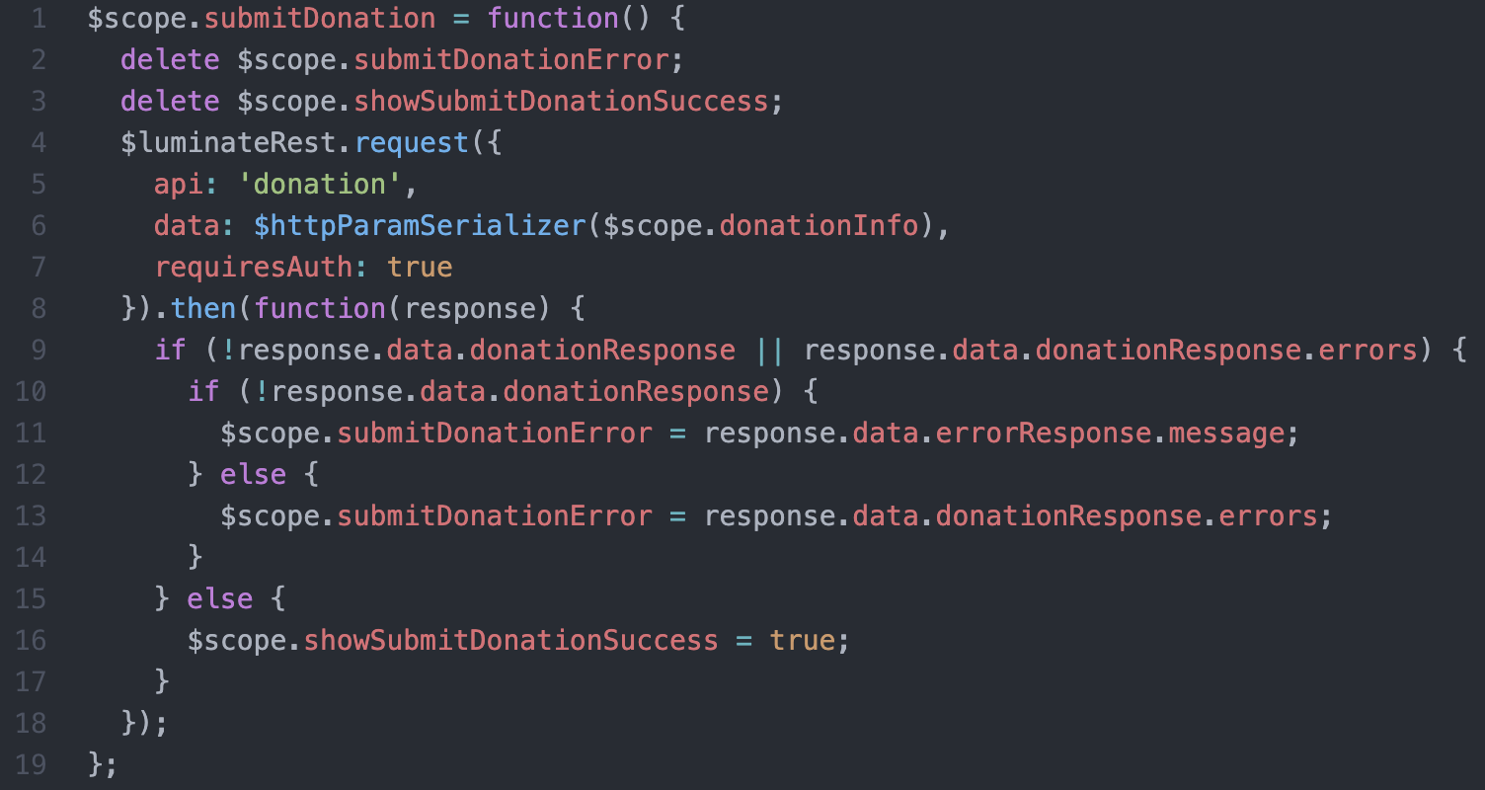
Donation Forms
donate

Slide 13
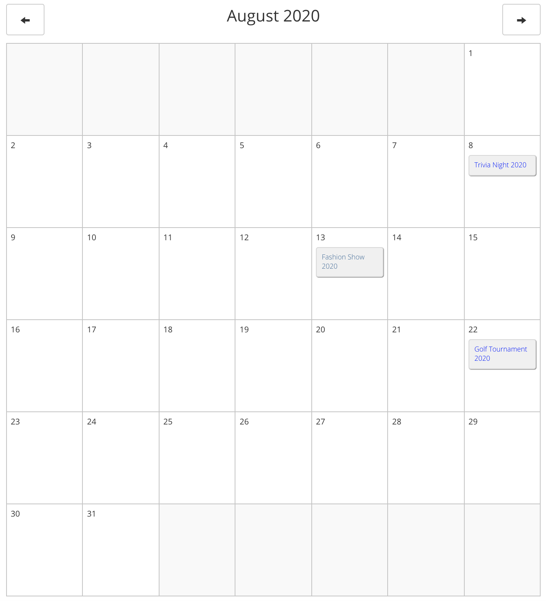
Events Calendar
getMonthEvents

Slide 14
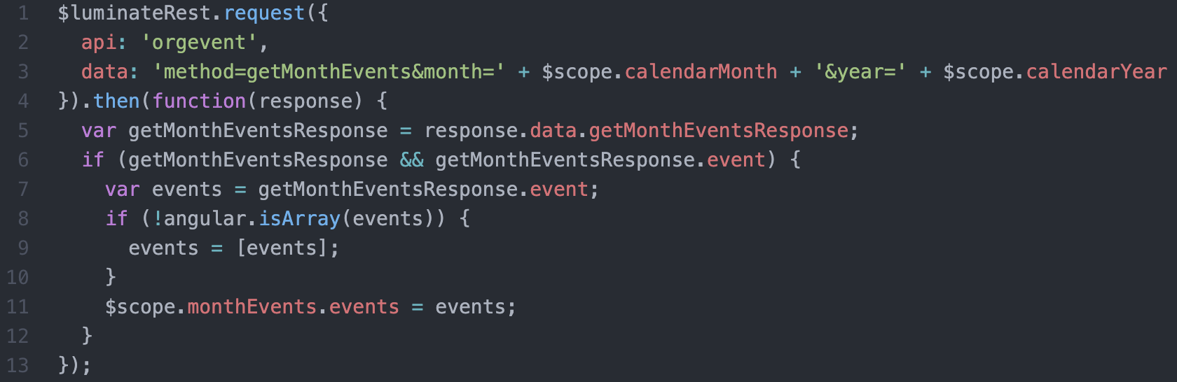
Events Calendar
getMonthEvents

Slide 15
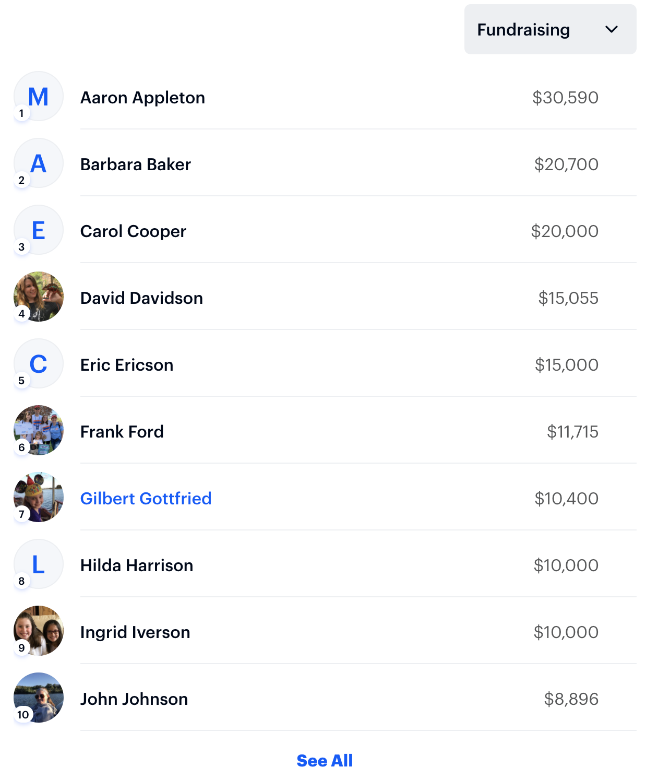
TeamRaiser Lists
getParticipants

Slide 16
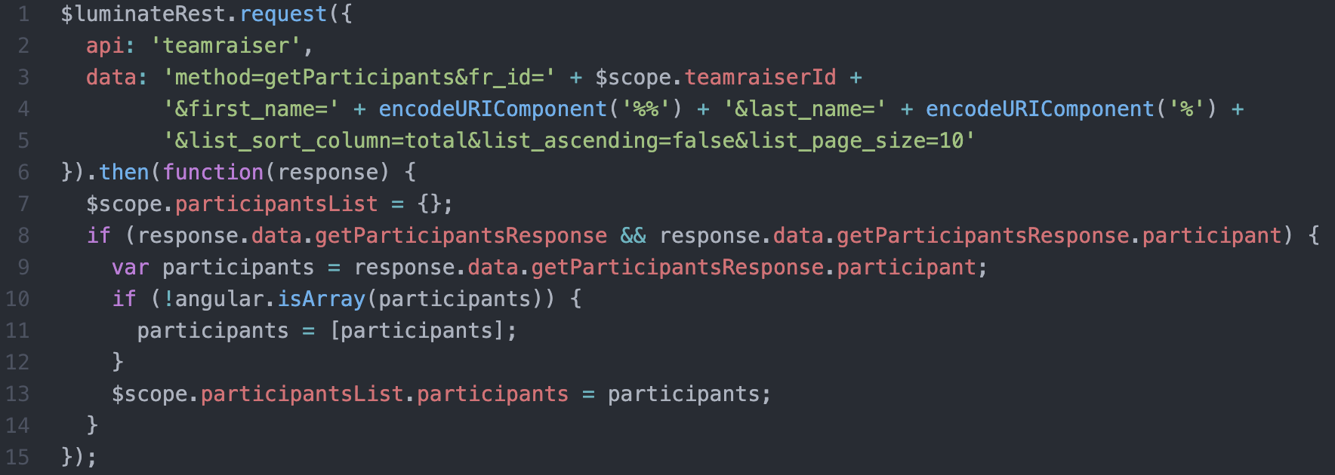
TeamRaiser Lists
getParticipants

Slide 17
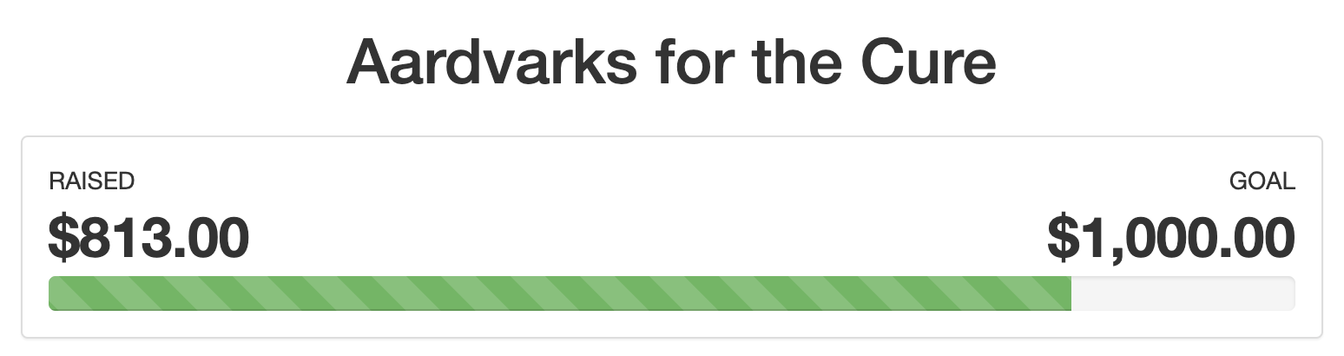
Luminate Template Tags
getTagInfo

Slide 18
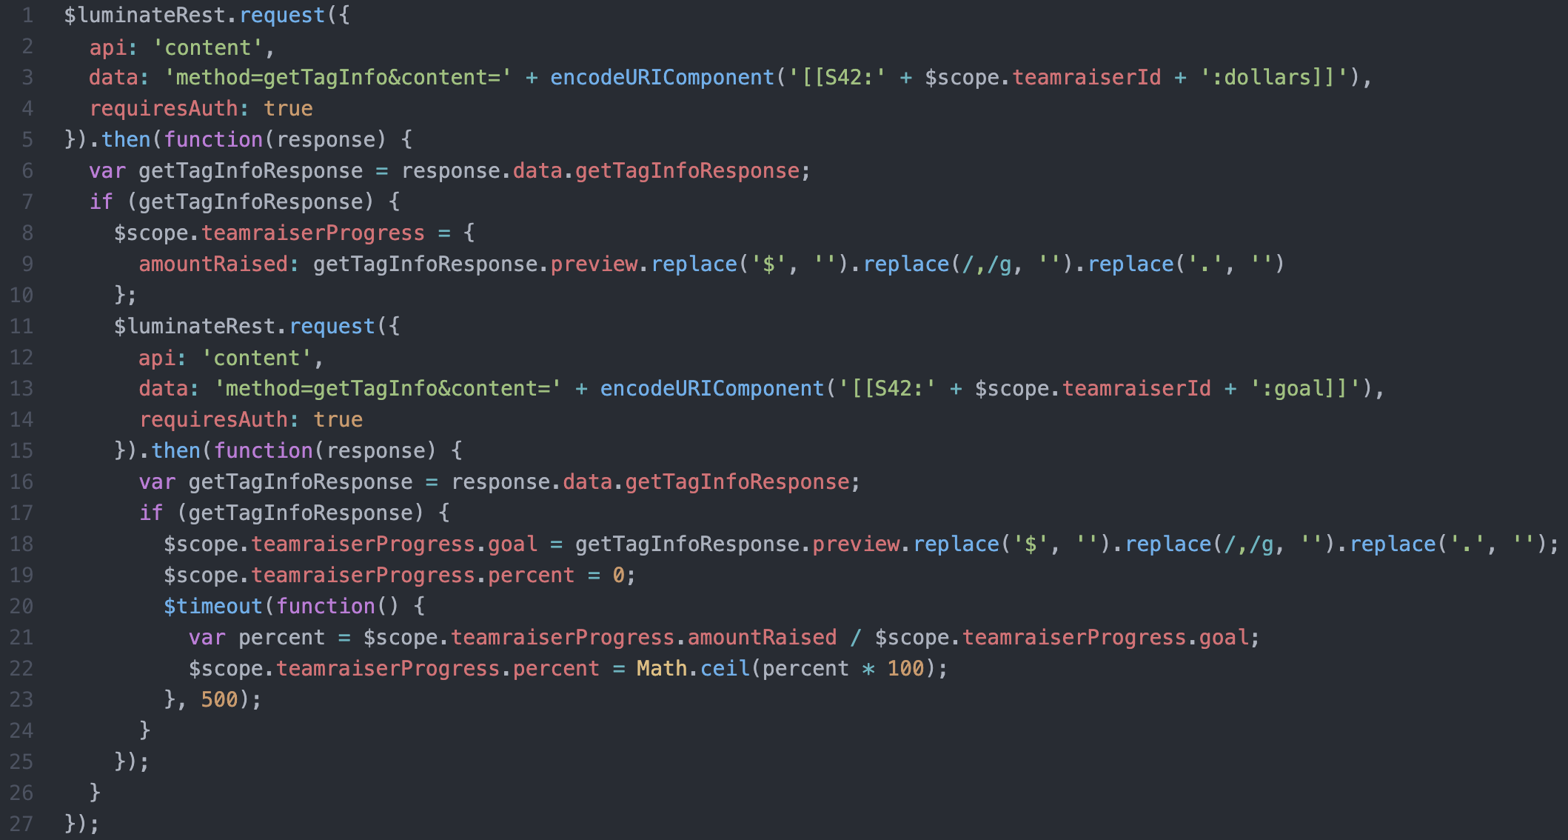
Luminate Template Tags
getTagInfo

Slide 19
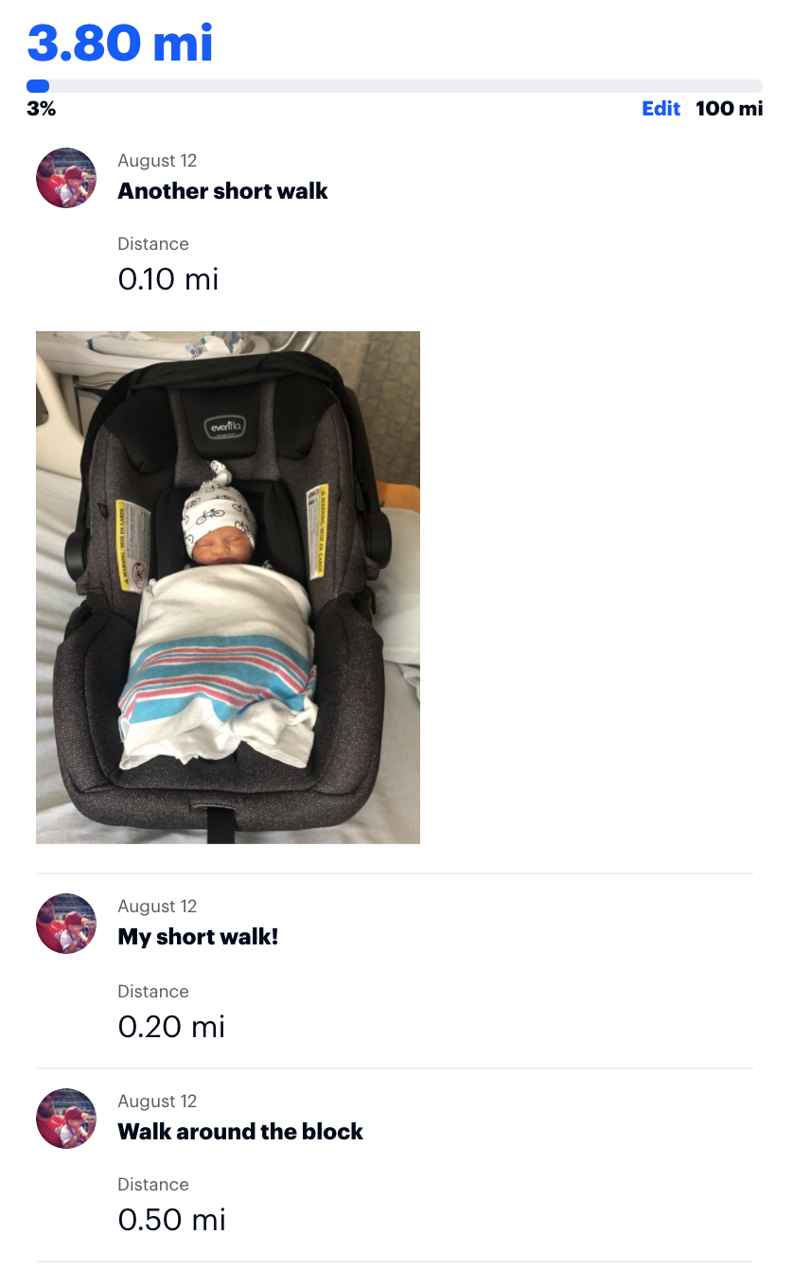
Custom Interactions
logInteraction listInteractions

Slide 20
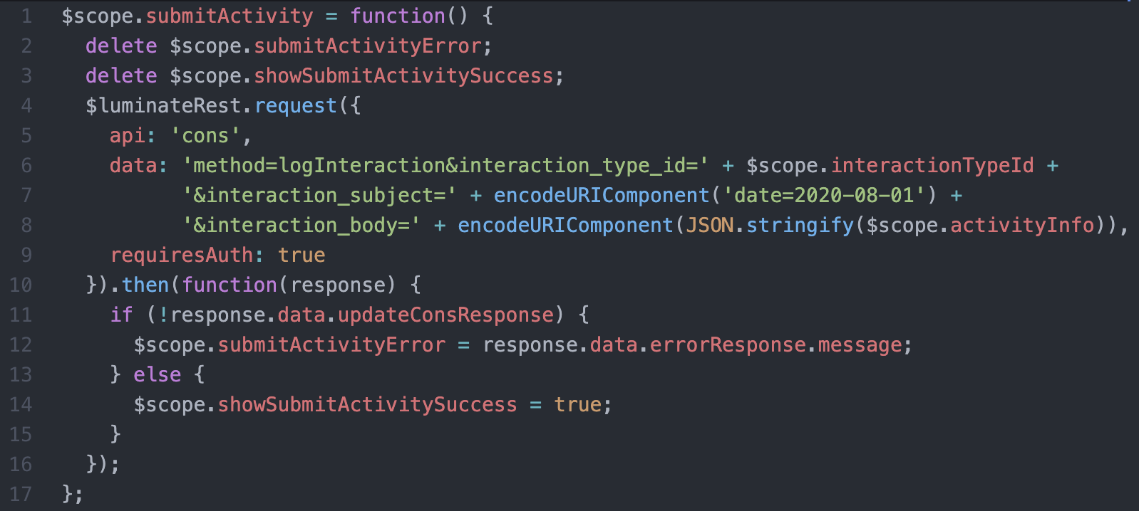
Custom Interactions
logInteraction

Slide 21
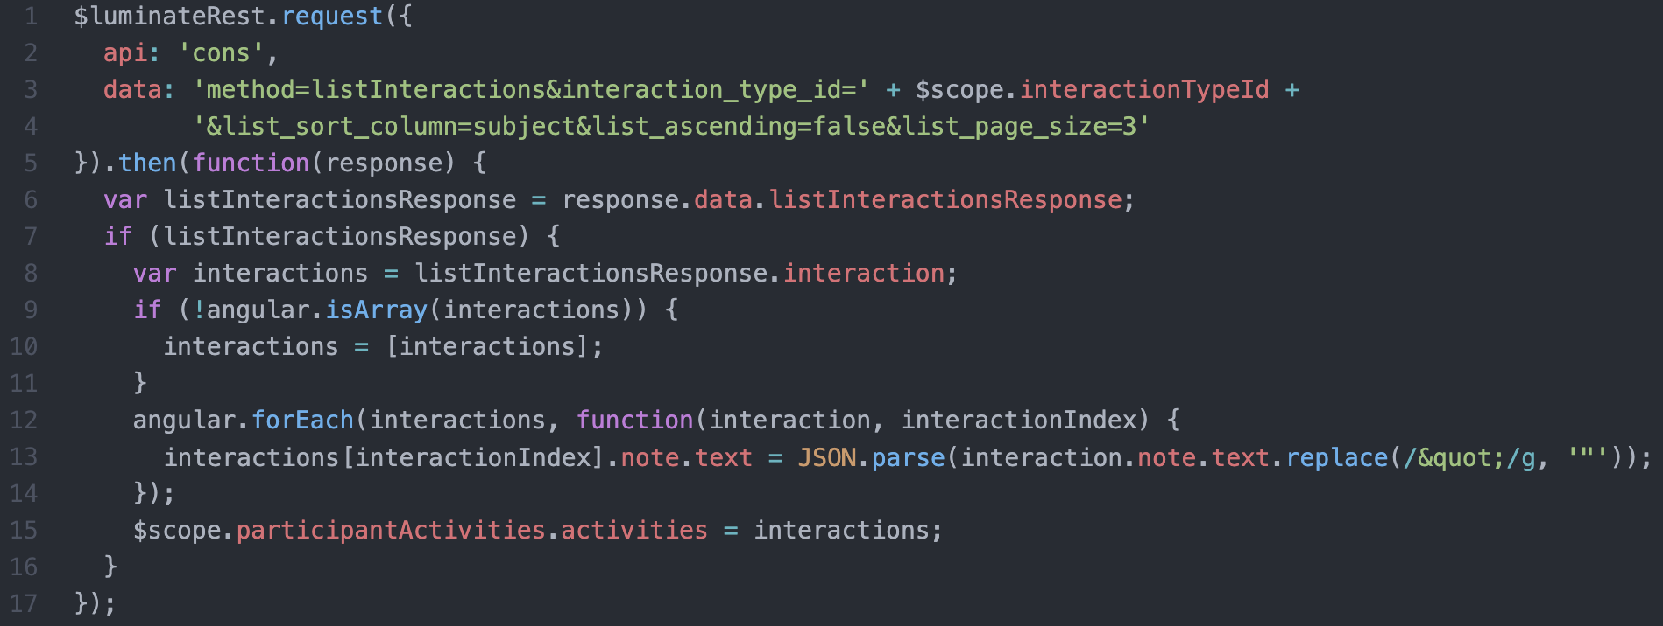
Custom Interactions
listInteractions

Slide 22

To learn more about the Luminate Online API, visit:
http://open.convio.com/api
Need assistance with your next API project? Contact your Customer Success Manager to find out how Blackbaud Professional Services can help!

Slide 23

linkedin.com/in/noahcooper

Slide 24



